Slide 1
Chicago/Illinois News NLP Analysis
MSCA 32018 – NLP – Spring 2022
Bhadri Vaidhyanathan
Notes:
background - brown - #3D372E - 61 - 55 - 46
light green - #E0ECE1 - 224-236-225
darker light green - #B2D0B4 - 178 208 180
bluish - #88A5BA - 136 165 186

Slide 2
Contents
EDA
Filtering
Clustering and Topic Modeling
Sentiment Analysis
WordCloud
Entity Recognition
Targeted Entity Sentiment – Using Google Cloud NL API

Slide 3
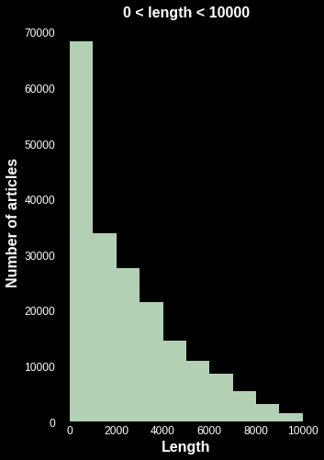
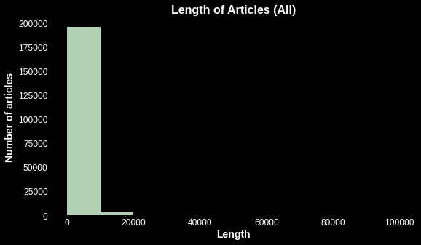
EDA
Total number of documents = 200,119
Average number of tokens/document = 537

Slide 4
Article Filtering
Preprocessing:
Lowercase, punctuations, numbers, whitespace
Lemmatization not performed*
Filtering:
Articles less than 750 characters dropped
Duplicate titles dropped
Keywords identified and articles filtered with keyword search
Keyword themes: sports terms, Chicago TV shows, popular spam terms
Filter 1:
Article length
(141K)
Filter 2:
Duplicate Titles
(105K)
Filter 3:
Keywords
(86K)
* Schofield, Alexandra et al. “Pre-Processing for Latent Dirichlet Allocation.” (2017)
Notes:
Schofield, Alexandra et al. “Pre-Processing for Latent Dirichlet Allocation.” (2017) : https://www.cs.cornell.edu/~xanda/winlp2017.pdf

Slide 5
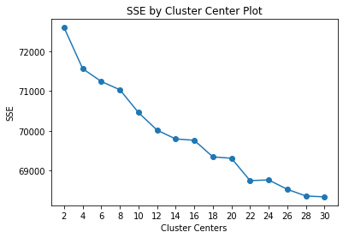
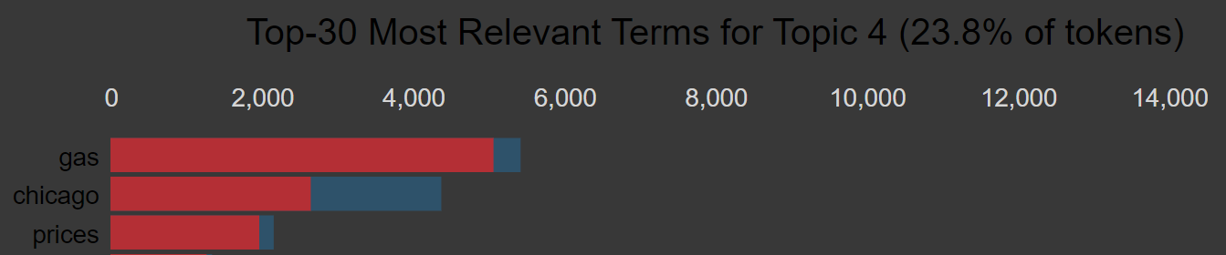
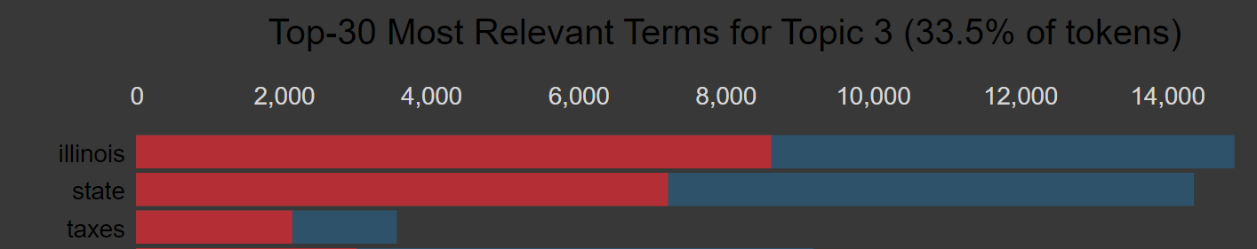
Clustering and Topic Modeling
clusters | cluster_topic | count
18 | Crime / Policing | 7839
20 | Crime | 1706
22 | Crime / Violence | 2695
0 | About Chicago/IL | 5500
4 | Chicago/IL: Tax and Gas prices | 2056
12 | Corruption | 1135
5 | Chicago/IL but less confidence | 7048
6 | Chicago/IL but less confidence | 26617
19 | Chicago/IL but less confidence | 10984
26 | Chicago/IL but less confidence | 7684
1 | Sports | 512
2 | headline and junk | 765
3 | Job posting | 1686
7 | Sports | 4253
8 | Covid | 1466
9 | Job posting - Medicine field | 549
10 | Ad block warning | 401
11 | Chicago weather | 1840
13 | junk | 2470
14 | Covid | 2140
15 | junk | 1123
16 | Investment firm | 3880
17 | Tv Show | 475
21 | junk | 393
23 | Ads | 641
24 | Schools & covid | 2117
25 | ukraine - russia war | 2115
Step 1: Deciding number of clusters
Step 2: Identify topics from TFIDF uni/bigrams and LDA / PyLDAvis Topic Modeling
k
Topic Identified: gas price / state tax
Hybrid Model of using TfidfVectorizer clustering and LDA/PyLDAvis used to identify relevant and irrelevant topics
The topic for some big clusters was not apparent and so above steps were repeated for that cluster alone to further identify relevant and irrelevant topics
Using these methods, highly relevant articles were identified and are highlighted in green in the adjacent table

Slide 6

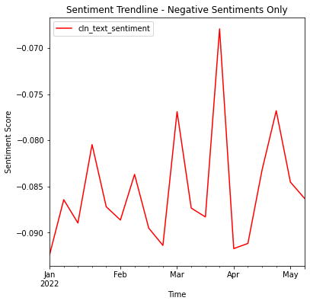
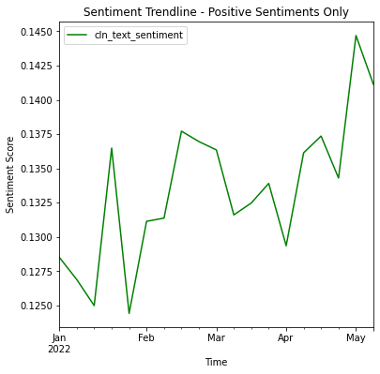
Sentiment Analysis
Algorithm used:
TextBlob (PatternAnalyser)
Negative sentiments have not changed much while Positive sentiments does have an upper slope
The scores are regardless close to zero indicating neutrality as observed in other models as shown in later slides

Slide 7
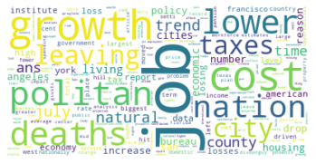
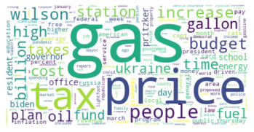
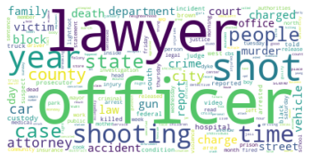
Wordclouds
Key articles on population decline
Key articles on Tax and Gas price cluster
Key articles on crime

Slide 8
Entity Recognition
Spacy NER
Medium pipeline was used
Top NERs were related ‘Person’ for the topics
Very few organizations showed up in the list although TFIDF Trigrams should many organizations
cluster_topic | NER (People & ORG) | Identification
Crime / Policing | ('mata', 112), ('draheim', 33), ('gloria', 28), ('hobley', 27), ('karen', 22), ('mendoza', 20), | criminals, victims, common names
Crime | ('russell knight', 16), ('larry rogers', 14), ('rogers', 9), ('joseph power', 6), ('rahul iyer', 6) | Popular Lawyers/firms in Chicago
Crime / Violence | ('evans', 11), ('balogh', 6), ('cunningham', 6), ('beltran', 6), ('gyovanny arzuaga', 6) | criminals, victims, common names
About Chicago/IL | ('madeleine albright', 43), ('chris oberheim', 34), ('kunstler', 32), ('abbie', 30), ('thompsons', 29), ('chris oberheim maranatha', 29), ('american legislative exchange council', 29), ('clay jackson herald', 28), | Politicians, Police Officer, Activist
Chicago/IL: Tax and Gas prices | ('scorp', 20), ('epa', 18), ('intuit', 12), ('irs', 9), ('garnishment', 8), ('avg gas price', 8), | Tax Org
corruption | ('madigan', 20), ('michael', 15), ('thompson', 15), ('mike frerichs', 14) ('irs', 9), ('ameren', 9) | Politicians

Slide 9
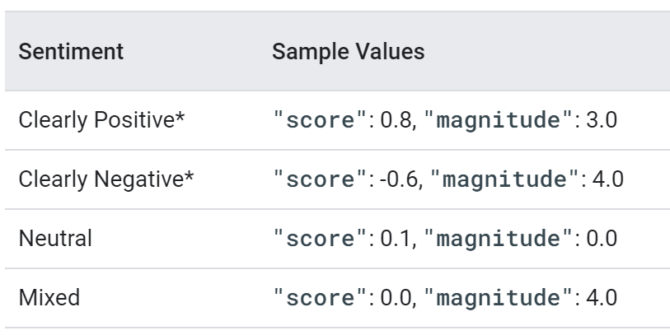
Targeted Entity Sentiment – Google API
Interpreting Entity Sentiment Results
Google Cloud NL API provides “Entity sentiment analysis” and can also be used to target few entities
Entities, “Chicago” and “Illinois” were selected for analysis
Substantial proportion are ‘Neutral”
Further evaluation needed for Targeted Entity Sentiment Analysis with specific articles
Sentiment Interpretation | Illinois | Chicago
Mixed | 4.89% | 6.50%
Neutral | 95.11% | 93.50%
https://cloud.google.com/natural-language/docs/sentiment-tutorial
https://codelabs.developers.google.com/codelabs/cloud-natural-language-python3
https://cloud.google.com/natural-language/docs/basics#interpreting_sentiment_analysis_values

Slide 10
Recommendations
General Goals:
Reduce corruption
For General Population
Reduce crime
Police should work to regain the trust of the people
Reduce cost of living (lower tax burden, lower gas price, property tax)
For Business
Reduce property tax to encourage business owners

Slide 11
Thank you!

Slide 12
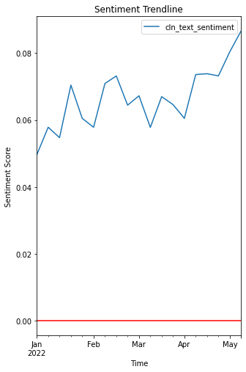
Appendix

